Slide 1
CPE 133
Review
Timing Diagrams
Example Problems

Slide 2
Review: Number Systems & Codes
Number system conversion
Any radix to decimal
Binary ↔ Hexadecimal
BCD ↔ decimal
Useful codes
Binary Coded Decimal (BCD)
One-hot codes
Unit Distance Codes

Slide 3
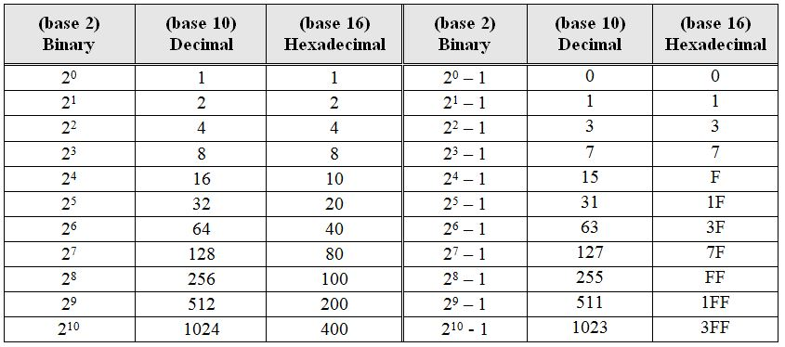
Important & Common Numbers

Slide 4
Digital Design Description
An approach to digital design:
Define the problem: understand the starting point and requirements
Describe your solution to the problem: propose your path to the solution
Implement your solution to the problem: embodiment of the solution
Main Design approaches:
BFD – brute force design (iterative design)
IMD – iterative modular design
MD – modular design

Slide 5
Digital Design Description
Example: Problem Statement - Design a digital circuit where the output of the circuit indicates when the 3-bit binary number on the input is greater than four.
A typical design approach:
Define the problem: understand the starting point and requirements
Describe your solution to the problem: propose a path to the solution
Implement your solution to the problem: embodiment of the solution

Slide 6
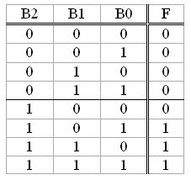
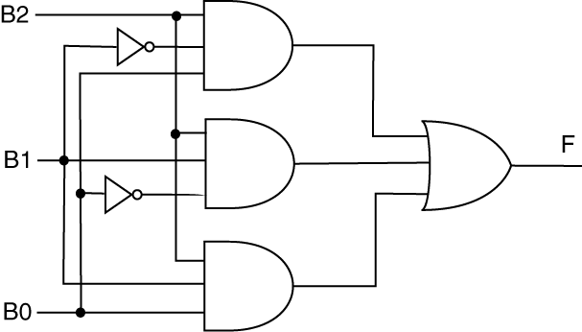

Four Equivalent Solution Descriptions
Circuit Description
Tabular Description
Written Description
Boolean Algebra Description

Slide 7
Example Problem
Write a Boolean equation describing the following circuit.

Slide 8
Example Problem
Write a Boolean equation describing the following circuit.

Slide 9
Timing Diagrams
Provide a visual representation of signal values
Plot of signal value (vertical axis) vs. time (horizontal axis)
Typical Uses
Specify designs
Specify parts of design
Verify Design
Simulation: ensure design is working
Troubleshoot designs
Hardware: output from Logic Analyzer

Slide 10
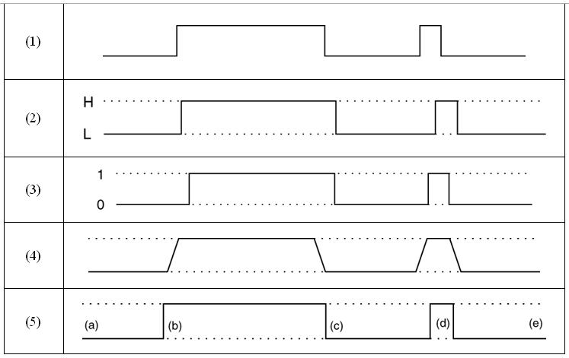
Timing Diagram Flavors

Slide 11
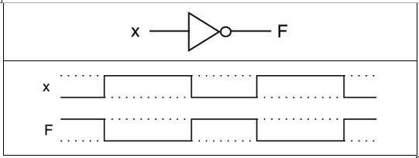
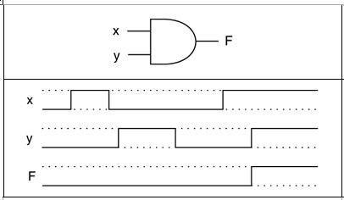
Timing Diagram Examples

Slide 12
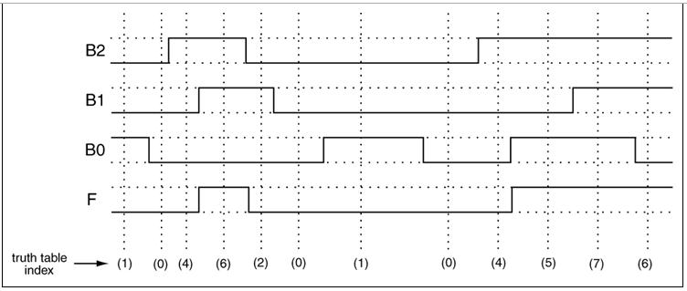
Function Specification
Does this timing diagram complete specify a function?

Slide 13
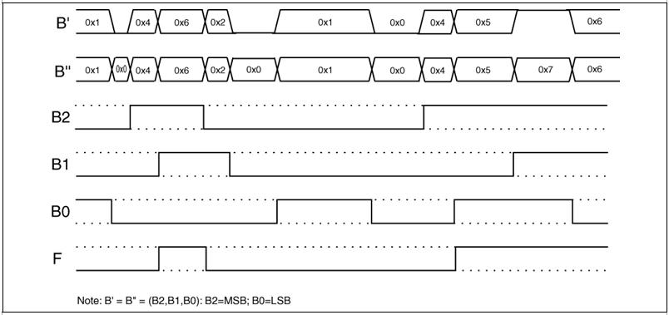
Timing Diagrams: Bundle Notation
Use if it makes your task clearer

Slide 14
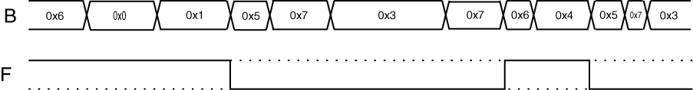
Example
Does the following signal completely specify a Boolean function? Briefly explain why or why not. Write the associated Boolean equation if this is a function.

Slide 15

Example
Does the following signal completely specify a Boolean function? Briefly explain why or why not. Write the associated Boolean equation if this is a function.

Slide 16
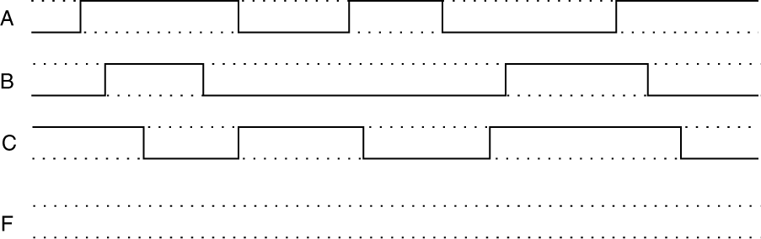

Example
Using the following Boolean equation to complete the accompanying timing diagram.
$$F=BC+A\overline{B}C+\overline{A}B\overline{C}$$

Slide 17
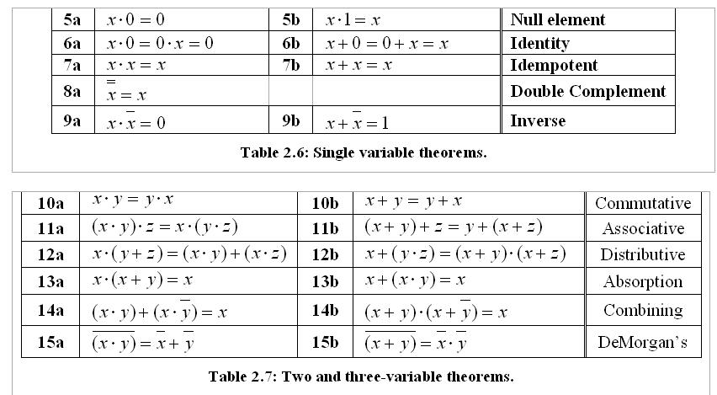
Boolean Algebra Theorems

